Slide 1

ICU SURVIVAL ANALYSIS
Yuling Gu
Alice Guo
Tam Nguyen

Slide 2

Outline
Business Use Case
Dataset
EDA & Approach
Modeling
Model Comparison
Conclusion
Lesson Learned
2

Slide 3

Business use case
PROBLEM STATEMENTS
objectives
In clinical practice, estimates of mortality risk can be useful in triage and resource allocation
Help hospital to:
determine appropriate levels of care
prepare discussions with patients and their families around expected outcomes
Help payers to know how the health outcomes of their policyholders will be affected, so that payers can identify useful policies
MIT's GOSSIS community initiative is seeking an efficient way to address the problems with existing severity of illness systems:
They often lack generalizability beyond the patients on whom the models were developed, and
The models are often proprietary, costly to use (APACHE scoring system…), and suffer from opaque algorithms.
Create a model that uses data from the first 24 hours of intensive care to predict patient survival with:
Better prediction probability of death (as compared to apache_4a_icu_prob, apache_4a_hospital_prob)
Minimize apache features
Transparent (easy to explain)
Generalizability
Less complexity
https://gossis.mit.edu/about/
Notes:
APACHE (Acute Physiology and Chronic Health Evaluation): severity score and mortality estimation tool developed from a large sample of ICU patients in the United States.

Slide 4

Data description
DATA
SOURCE
SHAPE
CATEGORY
MISSING VALUES
90K patients
Demographic
(18 features)
First hour 78%
GOSSIS & WDIS
186 features
Vitals
(52 features)
First hour
First 24 hour 50%
147 hospitals
Labs
(76 features)
First 24 hours
Covariate
(28 features)
https://gossis.mit.edu/about/
6 countries
Apache
(40 features)
Commodity
(12 features)
Notes:
APACHE (Acute Physiology and Chronic Health Evaluation)
Examples of features: blood pressure, temperature, respiratory rate, labs: albumin concentration, bilirubin concentration
Explain APACHE covariate: The bilirubin concentration measured during the first 24 hours which results in the highest APACHE III score

Slide 5

EDA & APPROACH
Data Cleaning & Feature Engineering
Initial Findings
Challenges
Approach
Assumption
Notes:
Each category: How many missing, feature, how to clean, how to impute

Slide 6
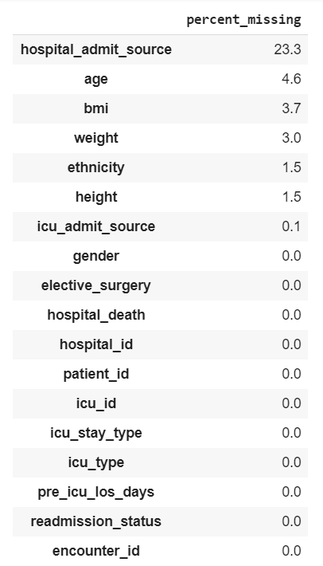
DATA CLEANING | DEMOGRAPHIC
FEATURES
CLEANING & IMPUTE
Drop features:
that add no value to the model with std = 0: readmission_status
encounter id (repeat with patient id)
1
Replace negative values with 0:
pre_icu_los_days (the length of stay (days) of the patient between hospital admission and unit admission)
2
Impute missing values: (Mice imputer & most frequent)
Mice imputer *: age, height, weight
calculate BMI based on height, weight and impute missing value for BMI
Most frequent value:
ethnicity
Impute either hospital_admit_source or icu_admit_source, based on the other: most frequent category for each group.
3
(*) https://stats.stackexchange.com/questions/421545/multiple-imputation-by-chained-equations-mice-explained
Notes:
Regression between 3 variables by using mice imputer: Multivariate imputation by chained equations

Slide 7
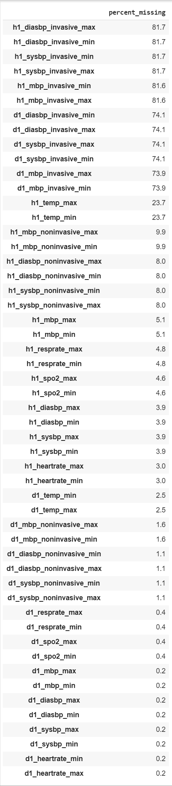
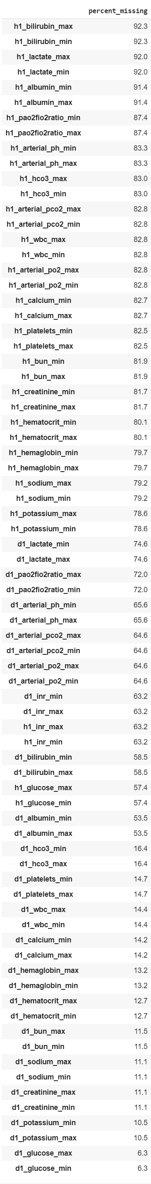
DATA CLEANING | VITALS - LABS
FEATURES
VITALS
LABS
Notes:
4 primary vital signs: body temperature, blood pressure, heart rate, and respiratory rate
Lab results: albumin concentration, bilirubin concentration, blood urea nitrogen (bun) concentration, calcium concentration, creatinine concentration, glucose concentration, bicarbonate concentration, hemoglobin concentration...
Invasive noninvasive drop
Calculate diff, then drop 1h 80%

Slide 8
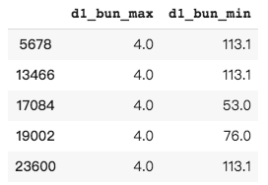
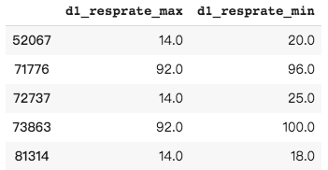
DATA CLEANING | VITALS - labs
CLEANING & IMPUTE
1
Min - Max problem ( max < min)
2
Impute & add in new features
Impute missing values for:
d1 features (max and min) based on the most frequent values of patients in the same apache_3j_bodysystem group
Add features:
calculated the difference between:
max and min value for every indicator, i.e. : 'diff_sodium_d1'='d1_sodium_max' - 'd1_sodium_min’;
1st hour and 1st 24 hours, i.e.: ‘diff_max_sodium_1hr_24hr’ , ‘diff_min_sodium_1hr_24hr’
pulse pressure = sysbp - diasbp (systolic blood pressure) - (diastolic blood pressure)
the severity of patients: based on the number of missing features
Consistent values
Different values by patients
Replace with nan
Flip the columns
3
Drop features
Multiple measurements for same indicator , i.e. 'mbp': mean blood pressure.
('d1_mbp_max','d1_mbp_min’) ; ('d1_mbp_invasive_max','d1_mbp_invasive_min’); ('d1_mbp_noninvasive_max','d1_mbp_noninvasive_min’)
Drop first hour data (more than 80% of missing values)

Slide 9
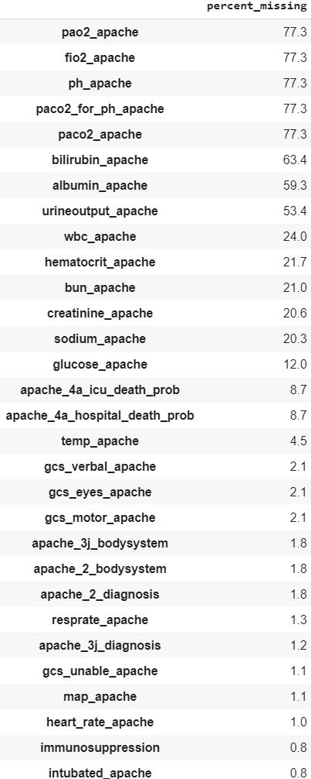
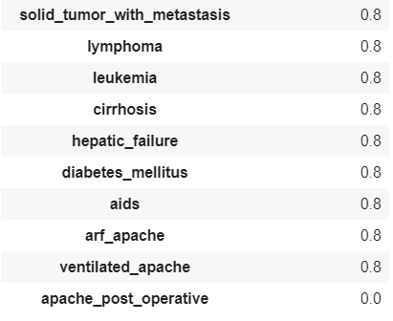
DATA CLEANING | APACHE (Acute Physiology and Chronic Health Evaluation)
FEATURES
CLEANING & IMPUTE
1
Drop features:
apache_2_diagnosis (the APACHE II diagnosis for the ICU admission)
apache_2_bodysystem (Admission diagnosis group for APACHE II), due to high correlation between apache II and apache III.
Impute:
apache score by using 1st 24 hours min, max values for the same measurements
Replace negative value of apache_icu_death_prob with 0
2
Create ‘Undefined’ category for missing values in apache_3j_bodysystem
APACHE: severity score and mortality estimation tool in US
Encode:
apache_3j_diagnosis: The APACHE III-J sub-diagnosis code which best describes the reason for the ICU admission, i.e.
203: Aspiration pneumonia
’203.01': Arrest, respiratory (without cardiac arrest)
3
Notes:
Impute apache score by using lab

Slide 10
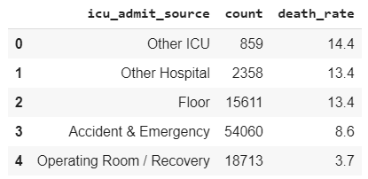
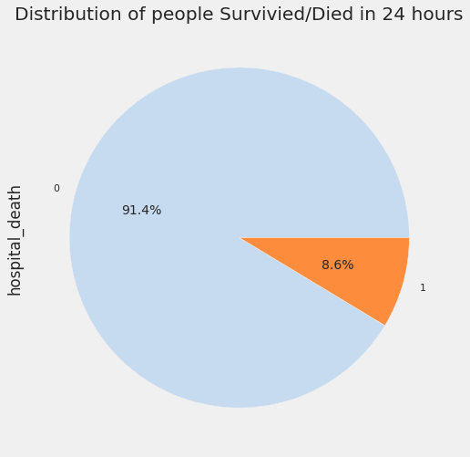
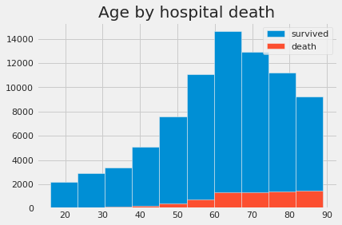
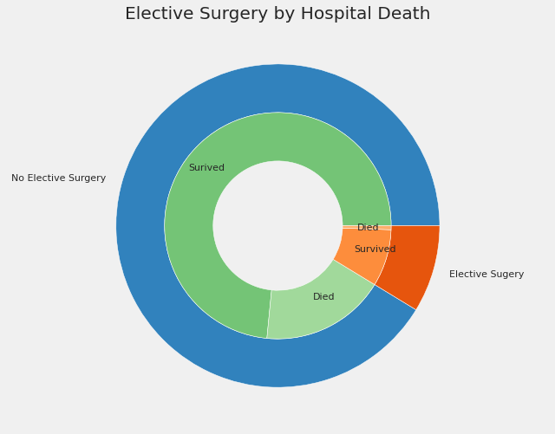
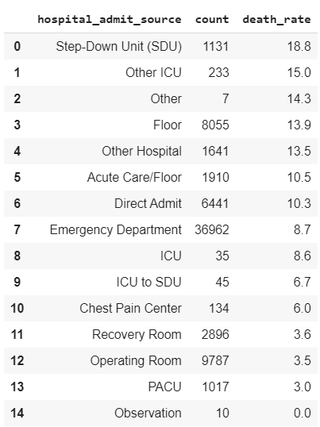
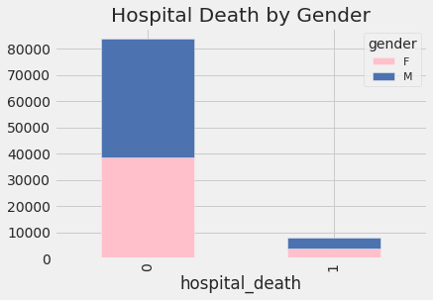
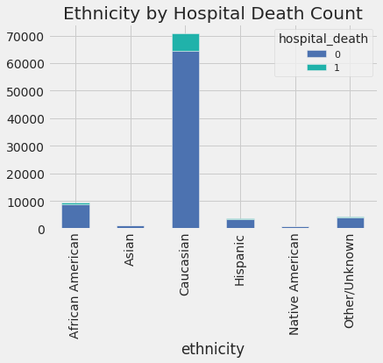
Initial FINDINGS (1)
Age, Gender, Ethnicity distribution with Hospital Death
No elective Surgery
Elective Surgery
Notes:
High imbalance
Age: older, high death rate
Gender: half half, not a big factor
Ethnicity: us
Elective: high proportion non elective
Admit source: mention top

Slide 11
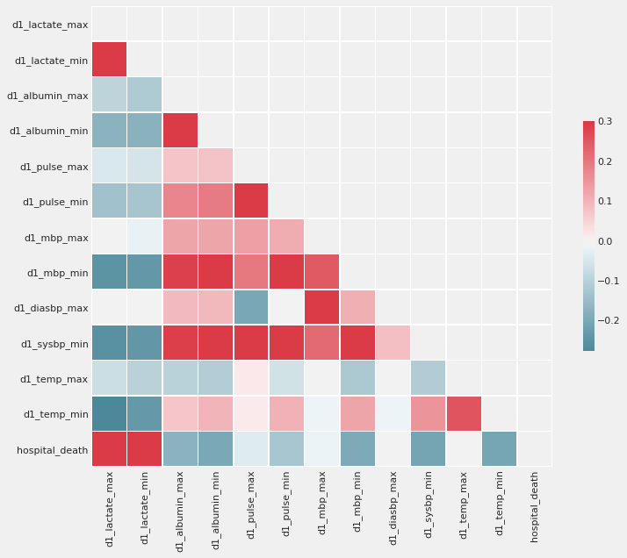
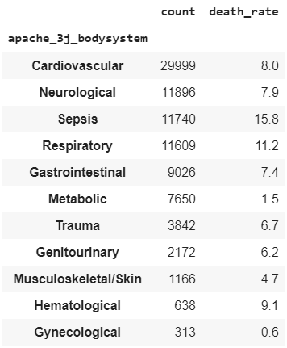
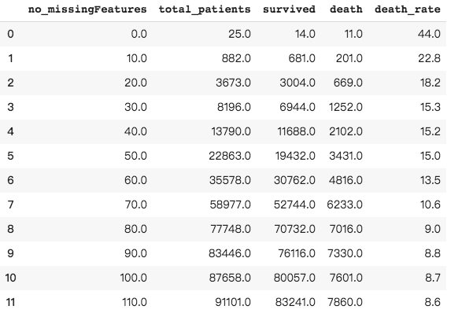
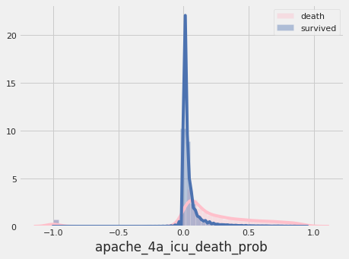
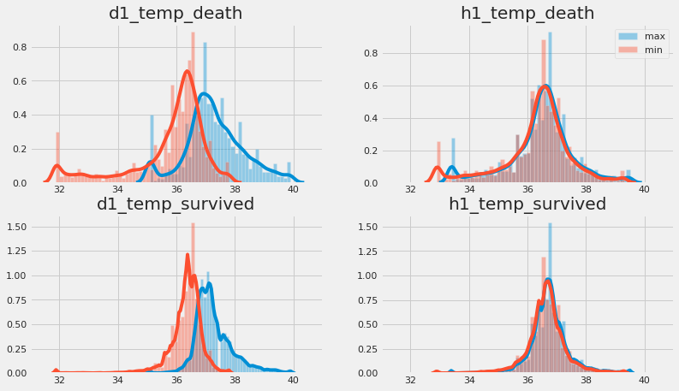
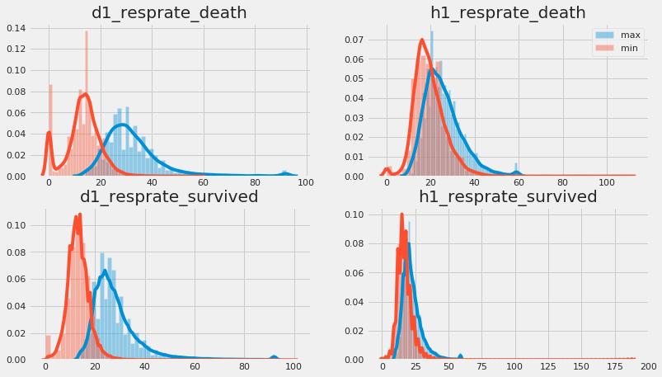
Initial FINDINGS (2)
Notes:
Severity of patient
Prob: 0.2 , actual death, compare probability with this
Hospital death: high correlated with lactate concentration max and min
Death rate related to disease
Low tem, high rate of death, but not resprate
D1 different>h1 different

Slide 12
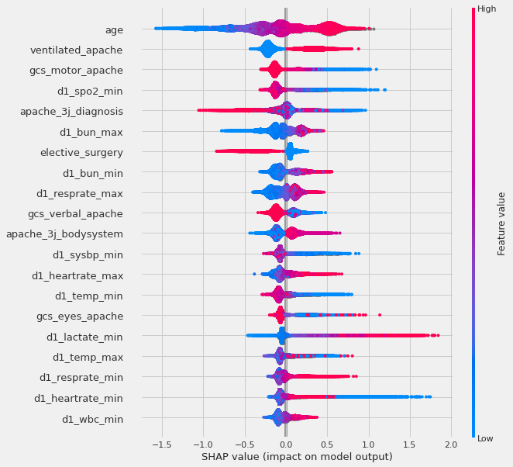
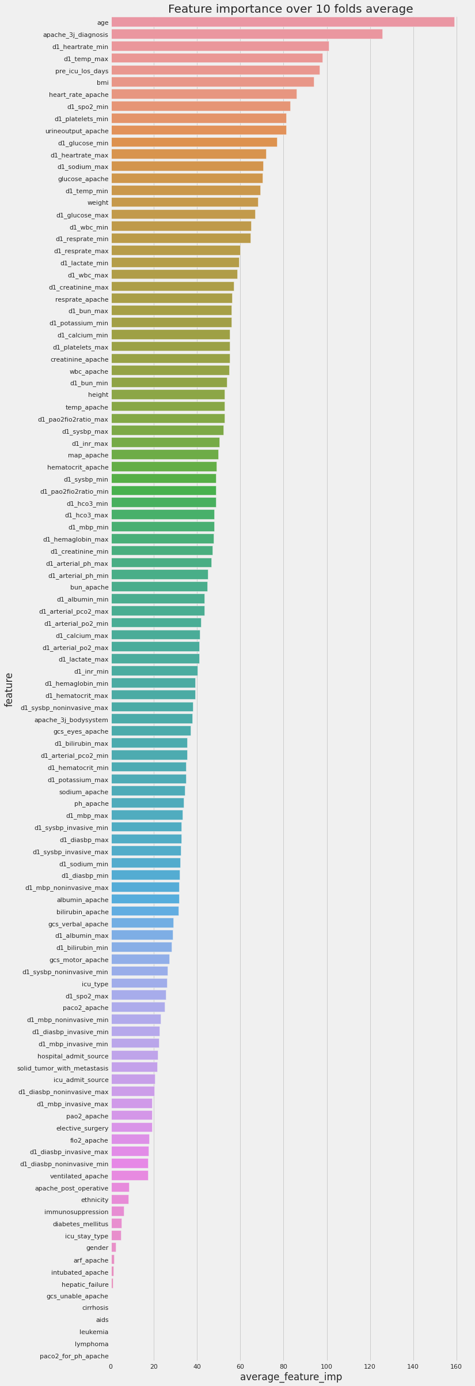
CHALLENGES
1
Shapley Explanator
LGB Feature Importance
Minimum domain knowledge
2
Highly imbalanced dataset
High dimensional data
4
Plenty of missing variables, hard to impute
3
INITIAL APPROACH
BASELINE MODEL - Light gradient boost
to have a better understanding of the dataset - using feature importance & Shapley Explanator
can deal with missing data
Oversampling – SMOTE to address imbalanced data problem

Slide 13
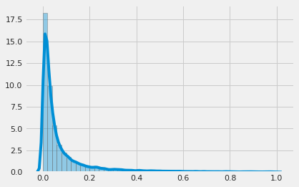
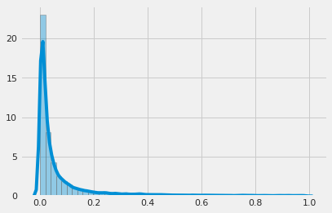
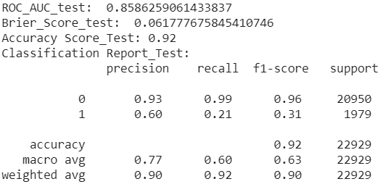
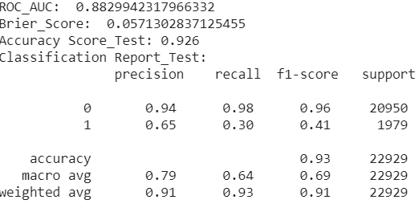
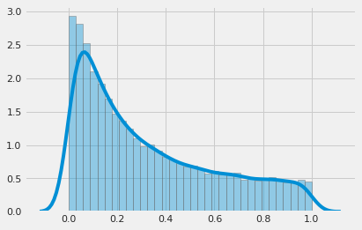
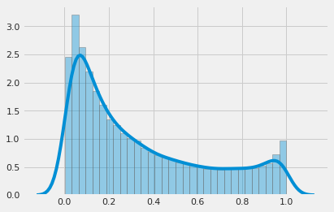
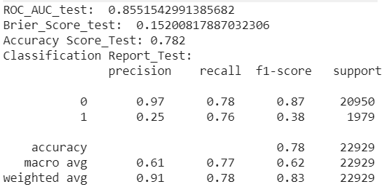
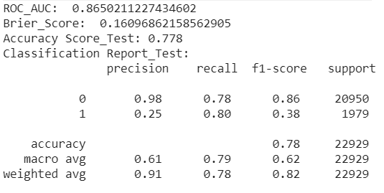
SMOTE – COMPUTATION EXPENSIVE BUT DOES NOT RESOLVE PROBLEM!
Impute Approach: Logistic Regression
Binning Approach: Logistic Regression
Without SMOTE
Without SMOTE
With SMOTE
With SMOTE
TRADE OF BETWEEN PRECISION – RECALL; HIGHER BRIER SCORE WHILE USING SMOTE

Slide 14
ASSUMPTION & SOLUTION
ASSUMPTIONS
Apache score is specialized to the US’s patients; therefore, it might not be appropriate measurements for patient from outside of the US.
Keep minimum features without losing accuracy
Any features that makes the model biased and less generalizable should be dropped
Our model only considers patient’s health, severity instead of hospital or ICU quality, level of care, etc.
SMOTE is not applicable for this data
Adjust probability instead of trying to balance the data
Patients with high missing features has lower survival rate overall
Assuming missing measurement as people who falls into normal range of the test results.
BUSINESS RELATED
MODEL BIAS
BALANCED DATA
MISSING VALUES
Try 2 different approaches:
keep provided apache score for modeling , and compare against
models that remove almost apache score having similar feature measurements to labs and vitals.
Drop features:
hospital_id, icu_id,
apache_4a_hospital_death_prob
apache_4a_icu_death_prob
gender, ethnicity
Adjust prediction probability to classify target variable based on quantile probability - 90% quantile
Using other metrics to evaluate the model instead of accuracy, i.e.: AUC, precision-recall, Brier score, …
Binning dataset (vitals | labs)
Bin it into 5 categories based on quantile
Treat missing value as another category (normal range)
Impute missing value using apache3j bodysystem
Features that has more than 50% missing values, fillna by 99
SOLUTIONS
Notes:
Pick 90% percentile: 8.6% of data: death

Slide 15

MODELING
Assessment Criteria
Models
Logistic Regression
Random Forest
Light Gradient Boosting
CatBoost
Neural Network
Model Selection

Slide 16
Model assessment criteria
1
2
AUC score
Brier Score
- Imbalanced dataset - False positive rate and true positive rate are more important than accuracy
- Higher the AUC score, means better model results
The lower Bier Score, the better model results
3
4
Precision- Recall
Complexity
- More balanced between two scores, means better model results
- Time takes model to run
- Number of features
- Less time and features make a good model
MODELING: USING STRATIFY SAMPLING ON ’HOSPITAL’_DEATH’ TO HAVE SAME PROPORTION OF BOTH TRAIN AND TEST

Slide 17
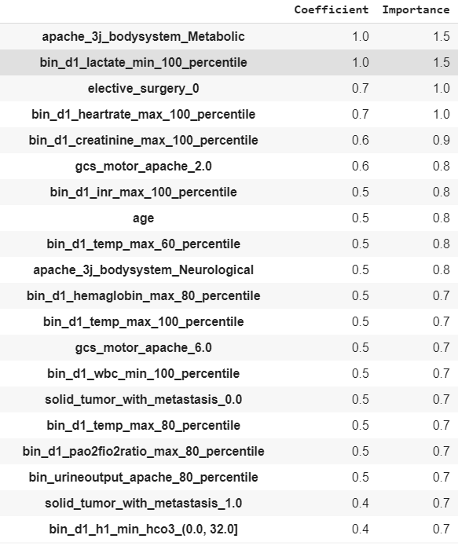
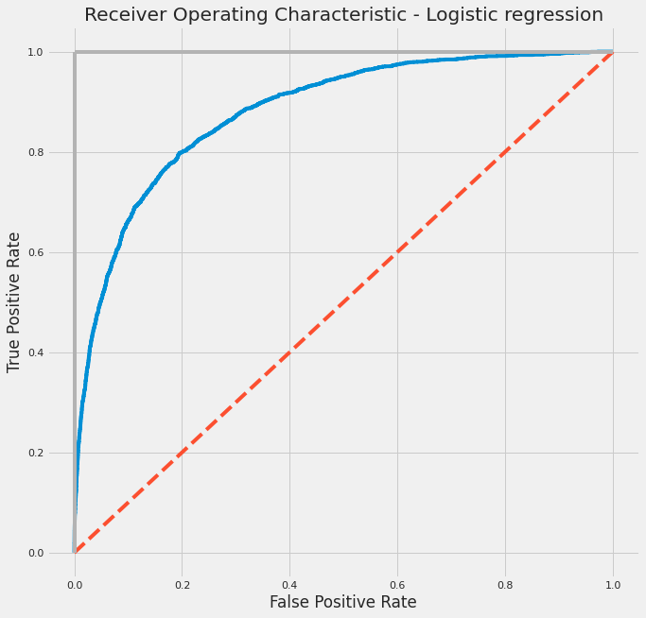
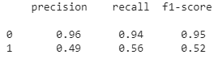
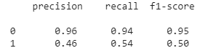
Logistic regression (1) – BINNING
Feature Importance
AUC
Train
Test
0.894
0.880
Brier Score
Train
Test
0.0549
0.0575
Classification Report_Train
Classification Report_Test
Complexity
Total number of features using: 463 features
Time running models: 13.4s (Colab)
Number of models tried: 10
COMMENTS: No signs of overfitting
Notes:
| Notes: Lactate_min_100_percentile [2.6,15.1], Heartrate_max_100_percentile[121,177]

Slide 18
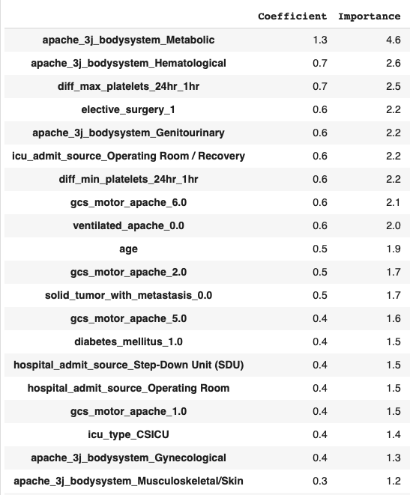
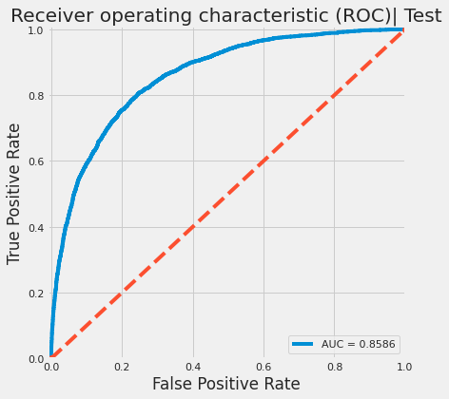
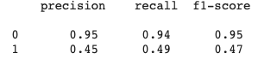
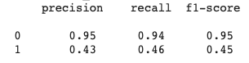
Logistic regression (2) – IMPUTING
Feature Importance
AUC
Train
Test
0.869
0.859
Brier Score
Train
Test
0.0596
0.0617
Classification Report_Train
Classification Report_Test
Complexity
Total number of features using: 177 features
Time running models: 9.85s (Colab)
Number of models tried: 2
COMMENTS: No signs of overfitting

Slide 19
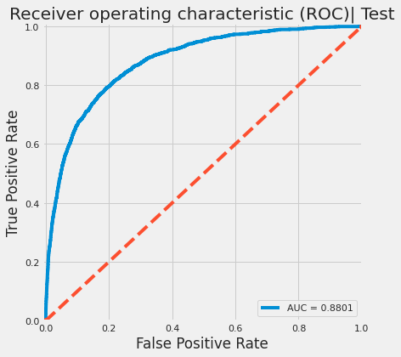
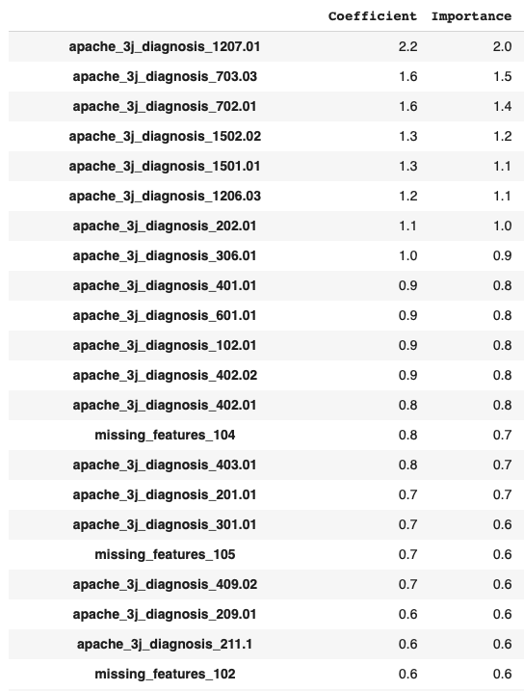
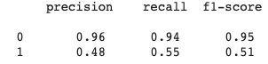
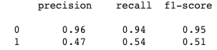
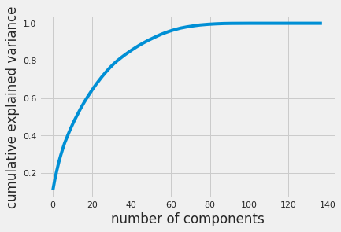
Logistic regression (3) – PCA
Feature Importance
AUC
Train
Test
0.891
0.880
Brier Score
Train
Test
0.0559
0.0579
Classification Report_Train
Classification Report_Test
Complexity
Total number of features using: 712 features
Using 70 out of 138 principle components
Time running models: 22.6s (Colab)
Number of models tried: 2
COMMENTS: No signs of overfitting, most of the top feature importance are binary data
Notes:
With improving test results, model is hard to explain

Slide 20
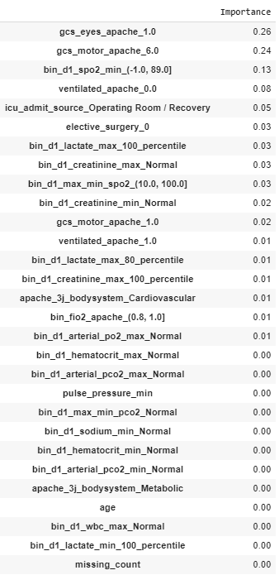
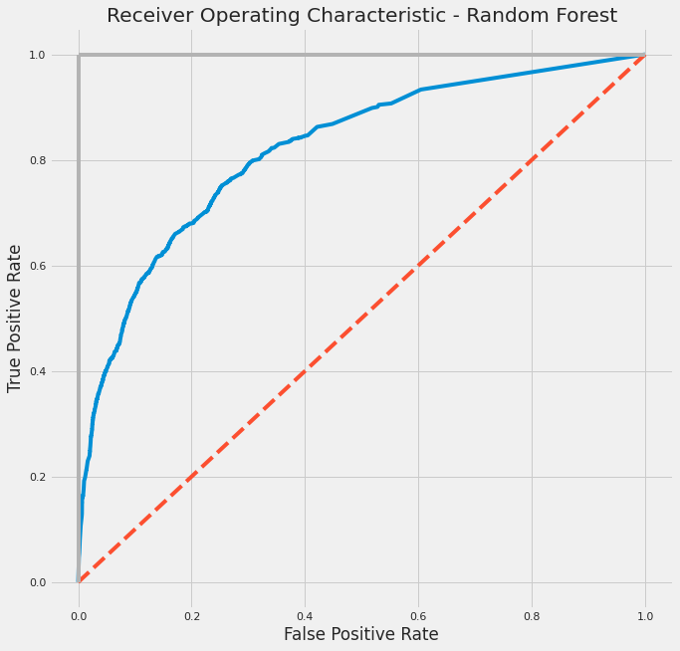
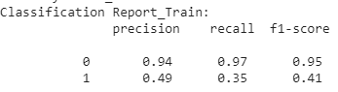
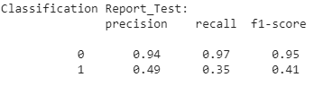
Random forest – BINNING
Feature Importance
AUC
Train
Test
0.823
0.820
Brier Score
Train
Test
0.0645
0.0644
Classification Report_Train
Classification Report_Test
Complexity
Total number of features using: 34 features
Time running models: 8.48s (Colab)
Number of models tried: 2
COMMENTS: No signs of overfitting, but poor performance on recall

Slide 21
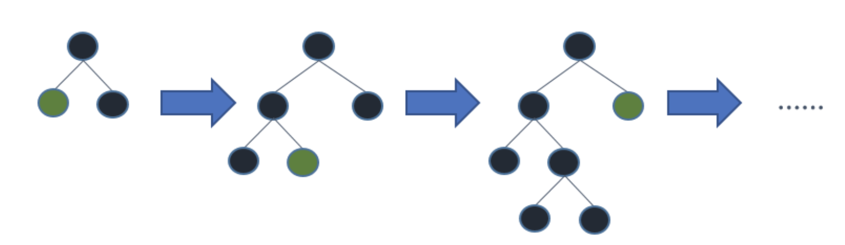
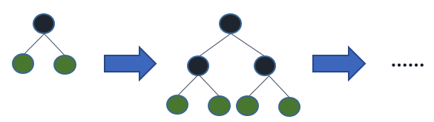
WHY WE USE LGB and catboost over xbg?
Function
XGB
CATBOOST
LGB
Can handle categorical variable: binning continuous variable to discrete variable based on histogram
Categorical variable
Can not handle categorical variable; only accept numerical variables
Can handle categorical variable automatically (one-hot max size encode)
Leaf-wise tree growth
Level-wise tree growth
filter out the data instances for finding a split value; can reduce more loss than the level-wise algorithm, resulting in much better accuracy which can rarely be achieved by any of the existing boosting algorithms
Tree growth
uses pre-sorted algorithm & Histogram-based algorithm for computing the best split
Time complexity
Take more time to run model, especially on high dimensional data
The algorithm reduce time for hyper-parameter tuning and and lower the chances of overfitting also which leads to more generalized models
Compatibility with large data set:
Reduce significant training time as compared to XGBOOST
https://towardsdatascience.com/catboost-vs-light-gbm-vs-xgboost-5f93620723db
https://www.analyticsvidhya.com/blog/2017/06/which-algorithm-takes-the-crown-light-gbm-vs-xgboost/

Slide 22
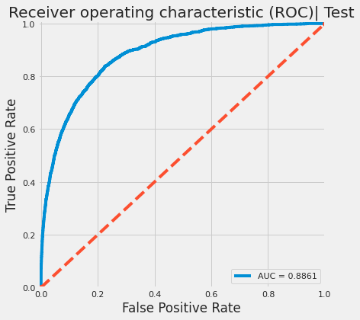



LgB – IMPUTING
Feature Importance
AUC
Train
Test
0.947
0.886
Brier Score
Train
Test
0.0417
0.0566
Classification Report_Train
Classification Report_Test
Complexity
Total number of features using: 177 features
Number of models tried: 4
Time running models: 8.15 mins (Colab)
With StratifiedKFold: 10 folds
COMMENTS: Signs of overfitting! Big gap between train and test on AUC score

Slide 23

LgB – SHAPLEY
Feature Importance
Notes:
Age – higher age – high chance of death
Diff bt man and min of sp2 – blood oxygen level – high gap – high death prob
Los – the longer : high prob of death
Metabolic – lower prob of death

Slide 24




Catboost – IMPUTING
Feature Importance
AUC
Train
Test
0.834
0.884
Brier Score
Train
Test
0.0765
0.0567
Classification Report_Train
Classification Report_Test
Complexity
Total number of features using: 107 features
Grid Search Parameters:
Learning rate: 0.04
Depth: 7
Time running models: 8 mins (Colab) + 1hr - GridSearch
COMMENTS: The model fits test better than on train. Regularization help removes overfitting (poorer on train) but more generalize on test

Slide 25


Catboost - ShaplEy
Feature Importance
Notes:
Age
Los
Spo2

Slide 26



PCA + Neural network (1)
Neural Network Model
Using 70 out of 138 principle components
Why using PCA for Neural Network?
Reduces computation complexity by reducing the size of the network, amount of data needed to train
Reduce overfitting
However, discriminative information that distinguishes the class might be in low variance components.

Slide 27





PCA + Neural network (2)
Train vs. Validation loss
AUC
Train
Test
0.912
0.890
Brier Score
Train
Test
0.0463
0.0546
Sparse – probability for both death and survived
Classification Report_Train
Classification Report_Test
Complexity
Total number of features using: 91,393 features
Time running models: 38.5s (Colab)
COMMENTS: No signs of overfitting
Notes:
Result pretty good for both AUC, Brier, precision, recall on test
Does not take long time
Sparse probability, even < 0.1 still death

Slide 28
Model COMPARISION & selection
No | Model | AUC | Brier Score | Precision | Recall | Run Time | No. features | Overfitting
1 | Logistic Reg - Binning | 0.880 | 0.0575 | 0.46 | 0.54 | 13.4s | 463 | No
2 | Logistic Reg - Imputing | 0.859 | 0.0617 | 0.43 | 0.46 | 9.85s | 177 | No
3 | Logistic Reg - PCA | 0.880 | 0.0579 | 0.47 | 0.54 | 22.6s | 712 | No
4 | Random Forest - Binning | 0.820 | 0.0644 | 0.49 | 0.35 | 8.48s | 34 | No
5 | LGB - Imputing | 0.886 | 0.0566 | 0.47 | 0.54 | 8.15 mins | 177 | Yes
6 | CatBoost | 0.884 | 0.0567 | 0.47 | 0.54 | 8 mins | 107 | No
7 | Neural Network - PCA | 0.890 | 0.0546 | 0.48 | 0.56 | 38.5s | 91,939 | No
Best performance in terms of AUC, Brier Score, Precision, Recall
Business related (less complexity + generalizable)

Slide 29



COMPARE THE WINNING MODEL WITH ACTUAL APACHE_4A_PROBABILITY
AUC
Classification Report_Logistic-Binning
Apache_4a
Logistic - Binning
0.794
0.880
The winner
Logistic_Binning
Brier Score
Classification Report_apache_4a
Apache_4a
Logistic - Binning
0.0656
0.0575
Notes:
Pattern of logistic prob and apache

Slide 30

SUMMARY
Conclusion
Lesson Learned
Future Work

Slide 31
CONCLUSION
LESSON LEARNT
FUTURE WORK
Logistic regression is a good model for this type of dataset
SMOTE does not help in this case since:
it does not take into account neighboring examples can be from other classes, introducing additional noise
is not very practical for high dimensional data
Binning: works well for extreme values, that shows importance in the model
Should not drop features or observations with high percentage of missing values without having a basic domain knowledge
Trade-off between explainability and interpretability. The best performance model does not have to be the one that being used in practical
Be creative! Our call to adjust the threshold instead of using the original probability threshold: 0.5 for imbalanced data
Try to use functions to utilize code
Have a better understanding about the features (domain knowledge)
Collect more data: Using GAN to generate more data instead of using SMOTE
Improve model prediction ability by:
Learning the key features importance of each model and try to combine such features
Applying Autoencoder to get a higher level of understanding the characteristics of patients who were misclassified with 'death’ or ‘survived’

Slide 32

THANK YOU!
32

Slide 33

APPENDIX

Slide 34
DICTIONARY
Features | Definition
ventilated_apache | Whether the patient was invasively ventilated at the time of the highest scoring arterial blood gas using the oxygenation scoring algorithm, including any mode of positive pressure ventilation delivered through a circuit attached to an endo-tracheal tube or tracheostomy
urineoutput_apache | The total urine output for the first 24 hours
map_apache | The mean arterial pressure measured during the first 24 hours which results in the highest APACHE III score
intubated_apache | Whether the patient was intubated at the time of the highest scoring arterial blood gas used in the oxygenation score
apache_post_operative | The APACHE operative status; 1 for post-operative, 0 for non-operative
arf_apache | Whether the patient had acute renal failure during the first 24 hours of their unit stay, defined as a 24 hours urine output <410ml, creatinine >=133 micromol/L and no chronic dialysis
gcs_unable_apache | Whether the Glasgow Coma Scale was unable to be assessed due to patient sedation
apache_3j_diagnosis | The APACHE III-J sub-diagnosis code which best describes the reason for the ICU admission

